Slide 1
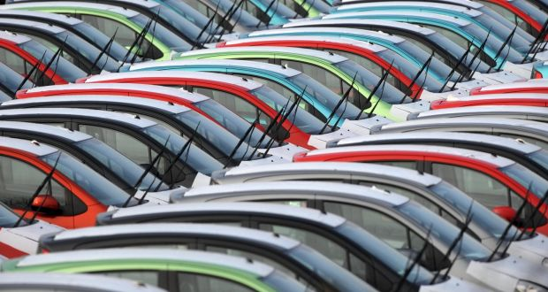
Exploratory Data Analysis On CAR SALES
By Venumadhav.B

Slide 2
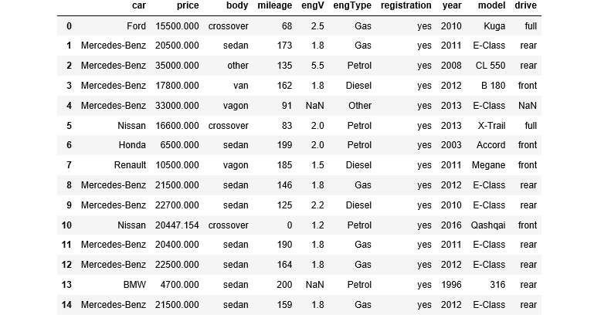
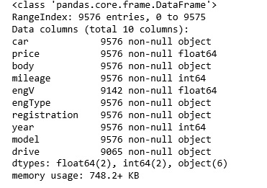
Data Loading and Description

Slide 3
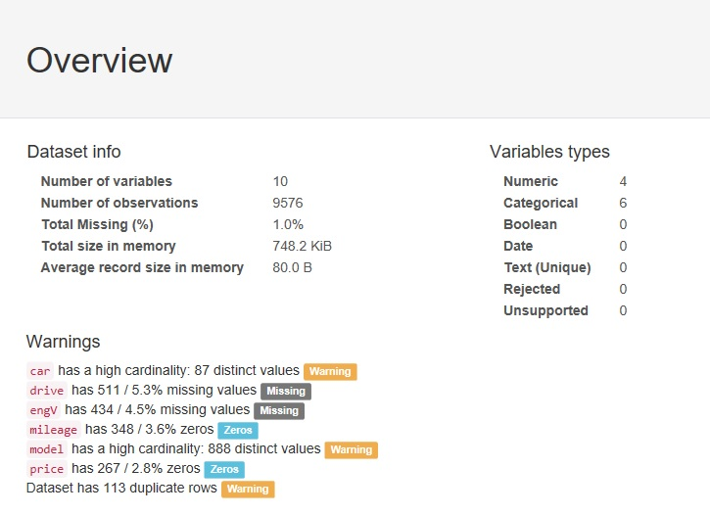
Pre Profiling BEFORE

Slide 4
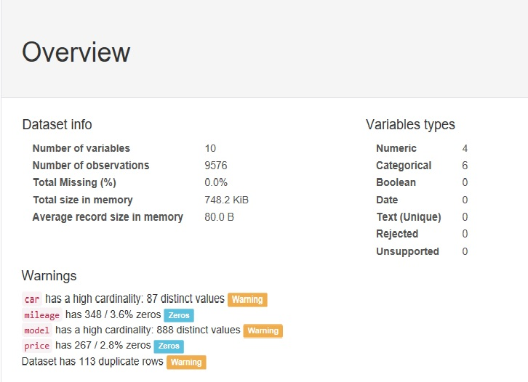
Post Pandas Profiling

Slide 5
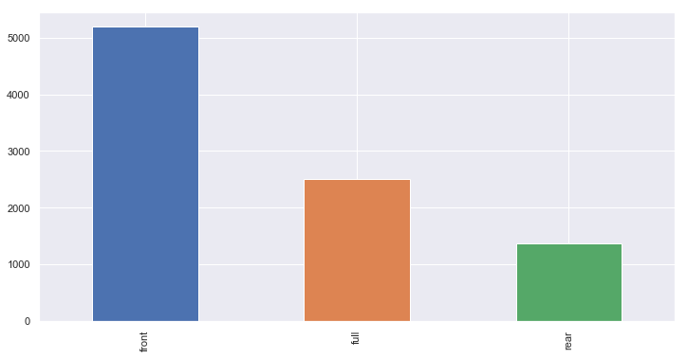
How many Cars sales based on Drive

Slide 6
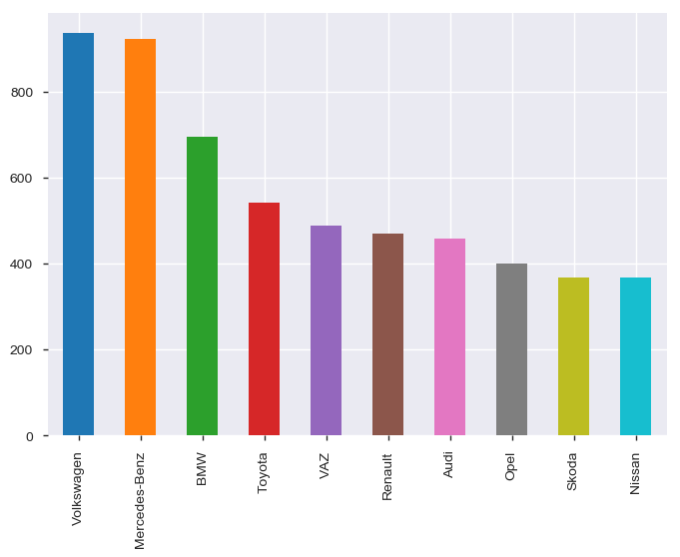
What is the Car sales rate considering the car variable

Slide 7
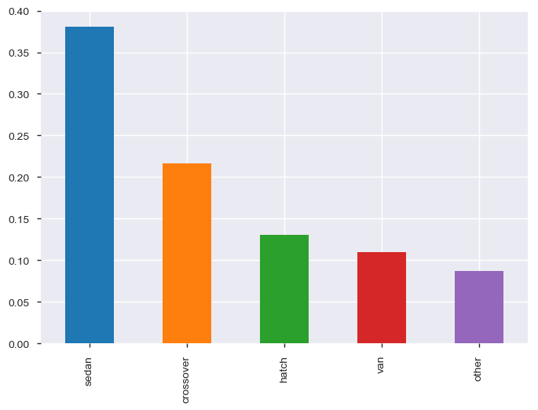
What is the rate of Car Sales on the base of body

Slide 8
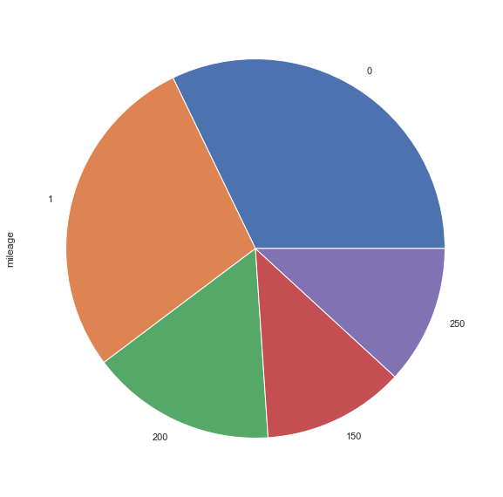
How mileage rate vary with cars

Slide 9
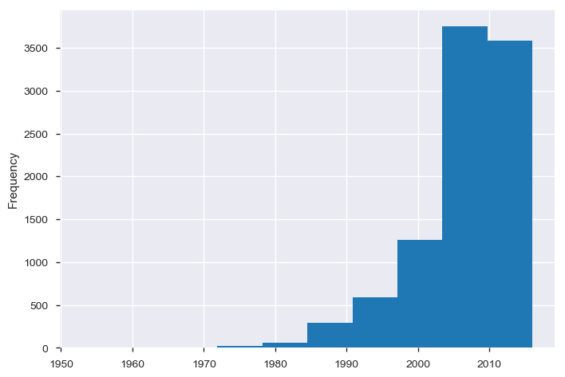
Car sales rate comparing with year

Slide 10
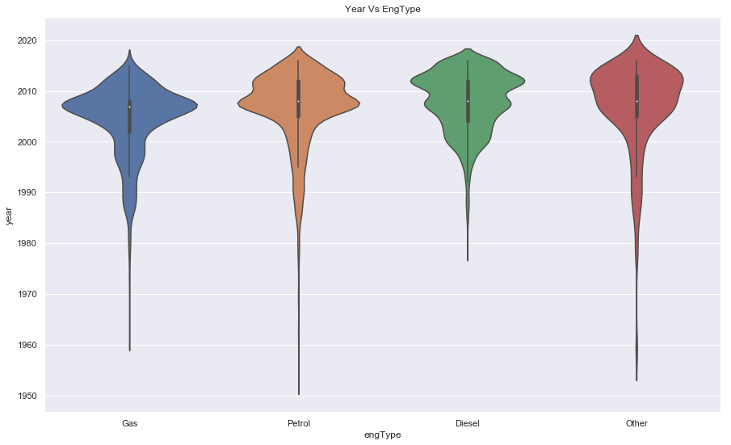
Analysing Engine type with year

Slide 11
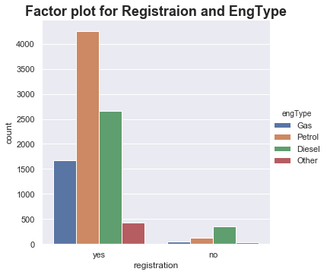
How many registered cars

Slide 12
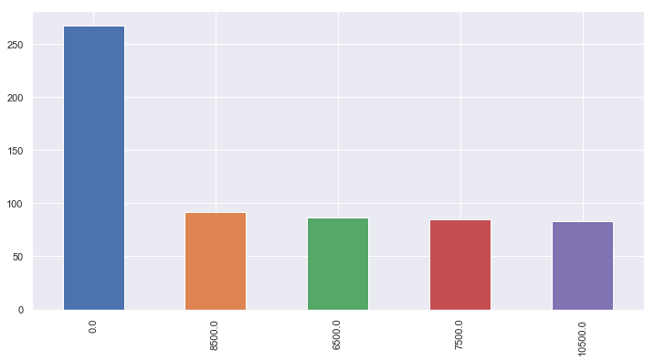
Car Sales based on Price Variable

Slide 13
Conclusions
With the help of this notebook how to exploratory data analysis can be carried out using Pandas plotting.
Also we have seen making use of packages like matplotlib and seaborn to develop better insights about the data.
We have also seen how preprocessing helps in dealing with missing values and irregualities present in the data.
We also make use of pandas profiling feature to generate an html report containing all the information of the various features present in the dataset.
We have seen the impact of columns like Car, body, year,milage,engine type

Slide 14
Thank You

